Slide 1


Final Year Project Proposal
Threat Track AI: Log Detection Using LLM Model With Agentic AI
Supervised By: Dr. Muhammad Mansoor Alam (Professor)
Industrial Supervisor: M Tayyab Ali (CTO)

Slide 2
Project Team
Danyal Khan(40856)
Khawaja Bilal Ahmad(41276)
Muhammad Javaid (40855)

Slide 3
Table of Content
Introduction and Background
Literature Review and Summary Table
Gap Analysis
Problem Statement
Proposed Solution & Methodology
Project Scope
Work Breakdown Structure
Roles and Responsibilities

Slide 4
Introduction And Background

Slide 5
Introduction
Threat Track AI is an AI-powered system for automated log analysis and real-time threat detection.
Uses LLMs and Agentic AI to classify logs, filter critical alerts, and provide instant solutions.
Locally deployable, ensuring security, faster processing, and operational efficiency.

Slide 6
Background
Modern IT systems produce huge logs, making real-time analysis and issue detection hard. Networks, apps, and security systems generate large amounts of data.
Challenges:
- High log volumes make it hard to detect security threats efficiently.
- Traditional methods rely on manual monitoring and predefined rules, which delay responses.

Slide 7
Literature Review

Slide 8
Literature Review [1/2]
Detection For Web Log Data The number and seriousness of cyberattacks have been expanding empathically in late years, and security issues are currently essential for the fundamental worry for the computer systems. An anomaly detection approach has a significant role to play in web security, becoming a key element of the security of web applications and the security of web itself.. [1]
Automated Log Analysis need to track a system’s behavior during its operation has been a common need since the beginning of software engineering. Traditionally, the main area of focus was failure diagnosis, and the most common form was the recording of actions taken by a system in log ﬁles. [2]

Slide 9
Literature Review [2/2]
Anomaly using LLM: when dealing with real-time applications that create massive logs for each micro service. Therefore it is highly important to have an automatic system to check service logs for abnormal behavior. Anomaly detection is a critical step in building a secure and trustworthy platform. Operational teams can mitigate losses by detecting anomalous sequences quickly and accurately. [3]

Slide 10
Paper | Authors | Year | Focus | Methodology | Key Findings
Issues and Challenges in Anomaly Detection for Web Log Data | M. Siwach, S. Mann | 2022 | Evaluates six anomaly detection techniques (3 supervised, 3 unsupervised) on web logs. | Uses a toolkit to analyze 15M+ log messages and 365K anomaly cases from public datasets. | Provides insights into the strengths of different anomaly detection methods.
Automated Log Analysis and Anomaly Detection Using ML | A. H. Shah, D. Pasha, E. H. Zadeh, S. Konur | 2022 | Develops an automated log anomaly detection model using ML. | Combines domain knowledge with ML to label logs and train a classification model. | Achieves 98% accuracy in detecting anomalies.
Log Anomaly Detection Using LLM-Based Parsing & Attention | A. Fariha, V. Gharavian, M. Masoud, A. Azim | 2024 | Uses LLM-based parsing and attention for anomaly detection. | Parses logs with LLMs, embeds representations, and applies an attention mechanism. | Enhances anomaly detection accuracy by leveraging LLM-based insights.

Slide 11
Gap Analysis

Slide 12
Gap Analysis
Lack of affordable AI-based log monitoring tools for localized deployment.
Existing solutions focus on anomaly detection but lack actionable insights.
No integration of Agentic AI for automated real-time log classification and response.

Slide 13
Problem Statement

Slide 14
Problem Statement
IT teams face alert fatigue due to excessive log alerts and lack automated solutions for detected issues.
Current AI-based tools detect anomalies but fail to provide actionable solutions.
Organizations need an end-to-end solution that integrates log collection, classification, response, and visualization.

Slide 15
Proposed Solution And Methodology

Slide 16
Proposed Solution
Threat Track AI will be locally deployable AI system that uses LLMs and Agentic AI to analyze logs, filter critical alerts, and provide real-time solutions.
Key Features:
- Real-time & day-wise log analysis
- LLM-based classification of logs
- Agentic AI integration for autonomous log processing

Slide 17
Methodology
Data Collection: Logs from multiple sources.
Preprocessing: Removing noise, structuring data.
LLM Classification: Detect security threats & categorize logs.
AI Agents: Identify log patterns, provide automated responses.
Continuous Monitoring: Ensuring real-time threat detection.

Slide 18
Project Scope

Slide 19
Project Scope
Dynamic AI-powered log analysis adapting to different log types.
Log processing to uncover recurring threats.
Customizable AI agents to support future scalability.

Slide 20
Constraints And Limitations

Slide 21
Constraints And Limitations
Scalability Issues: Large-scale deployments may require infrastructure upgrades (GPUs).
Another constraint is building a custom LLM from scratch, rather than using a pre-trained model.
Local Deployment Only: The model must be deployed locally, so no cloud integration is included in this project.
No Direct Action: The model only provides suggestions for issue resolution but does not execute any actions automatically.

Slide 22
Work Breakdown Structure [1/2]
Log Ingestion & Collection
Connect with the log file
Set up Socket.io / HTTP / GraphQL for real-time log ingestion
Backend Development (FastAPI Server)
Set up FastAPI server
Develop API endpoints for log submission & retrieval
3. AI Model Development (LLM with Agentic AI)
Implement Classifier Agent (critical vs. non-critical logs)

Slide 23
Work Breakdown Structure [2/2]
Implement Responder Agent (response on critical)
4. Integration
database for storing logs
5. Alert & Notification System
Develop real-time alert mechanism
6. Dashboard Development
Build a frontend dashboard (React, tailwind)

Slide 24
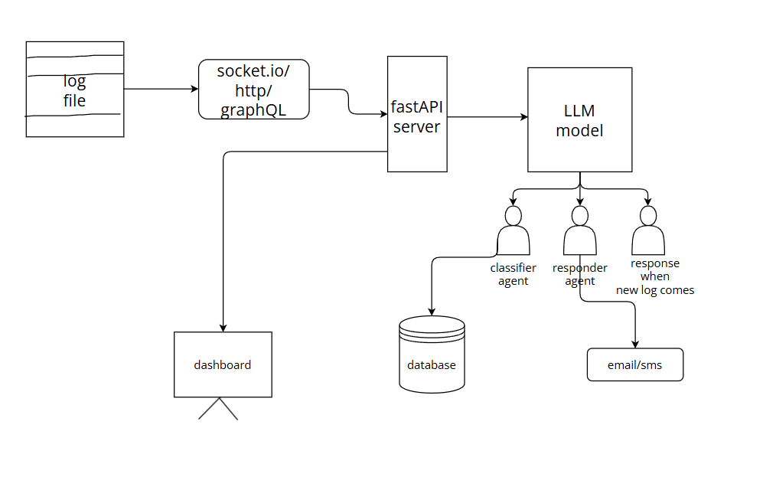

Slide 25
Roles And Responsibilities
Number | Roles | M . Javaid (AI/Model) | Danyal Khan (Backend/Integration) | Bilal Ahmad (Frontend/Testing)
1 | Data collection and preprocessing | ✔️
2 | Front-end development |  |  | ✔️
3 | Back end Development |  | ✔️
4 | Model Development | ✔️
5 | Model Evaluation | ✔️
6 | Model integration |  | ✔️
7 | Testing and Debugging |  |  | ✔️
8 | Documentation | ✔️ | ✔️ | ✔️
9 | Deployment |  | ✔️ | ✔️
10 | Maintenance |  | ✔️ | ✔️

Slide 26
References
[1] M. Siwach and S. Mann, “ISSUES AND CHALLENGES IN ANOMALY DETECTION FOR WEB LOG DATA,” vol. 9, no. 6, 2022.
[2] Shah, A. H., Pasha, D., Zadeh, E. H., & Konur, S. (2022). Automated Log Analysis and Anomaly Detection Using Machine Learning. Frontiers in Artificial Intelligence and Applications, 358, 137–147. https://doi.org/10.3233/FAIA220378
[3] Asma Fariha, Vida G, M. Masoud, Akrammul A,“Log Anomaly Detection by Leveraging LLM-Based Parsing and Embedding with Attention Mechanism,” Canadian Conference on Electrical and Computer Engineering (2024) 859-863

